Slide 1


The Power of Knowledge Graphs and Semantic Search
Collective intelligence of agents
By
M K Pavan Kumar
& Sashank Pappu

Slide 2
The Challenge of Enterprise Information Overload Drowning in Data, Thirsty for Wisdom.
The Problem: The volume of enterprise data—from CRMs, internal wikis, financial reports, and communication logs—is growing exponentially. Teams spend more time searching for information than using it.
The Business Impact: This overload leads directly to employee burnout, duplicated work, missed sales opportunities, and ultimately, suboptimal business decisions and rising operational costs.
The Core Question for Business: How do we empower our teams to find the exact piece of information they need, at the moment they need it, to make a critical business decision?

Slide 3
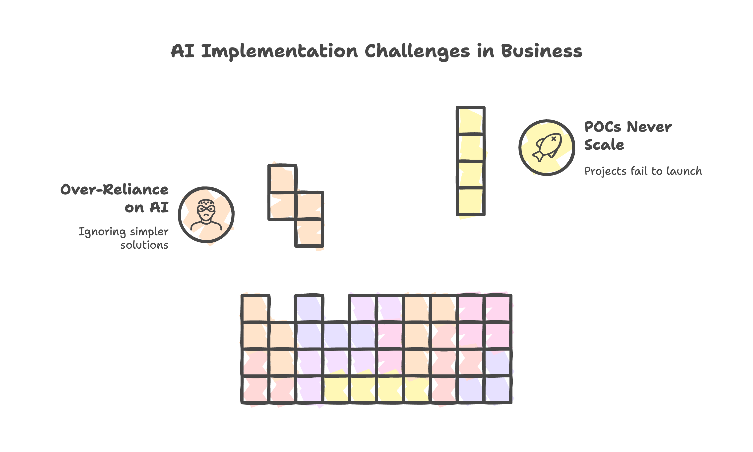

Slide 4
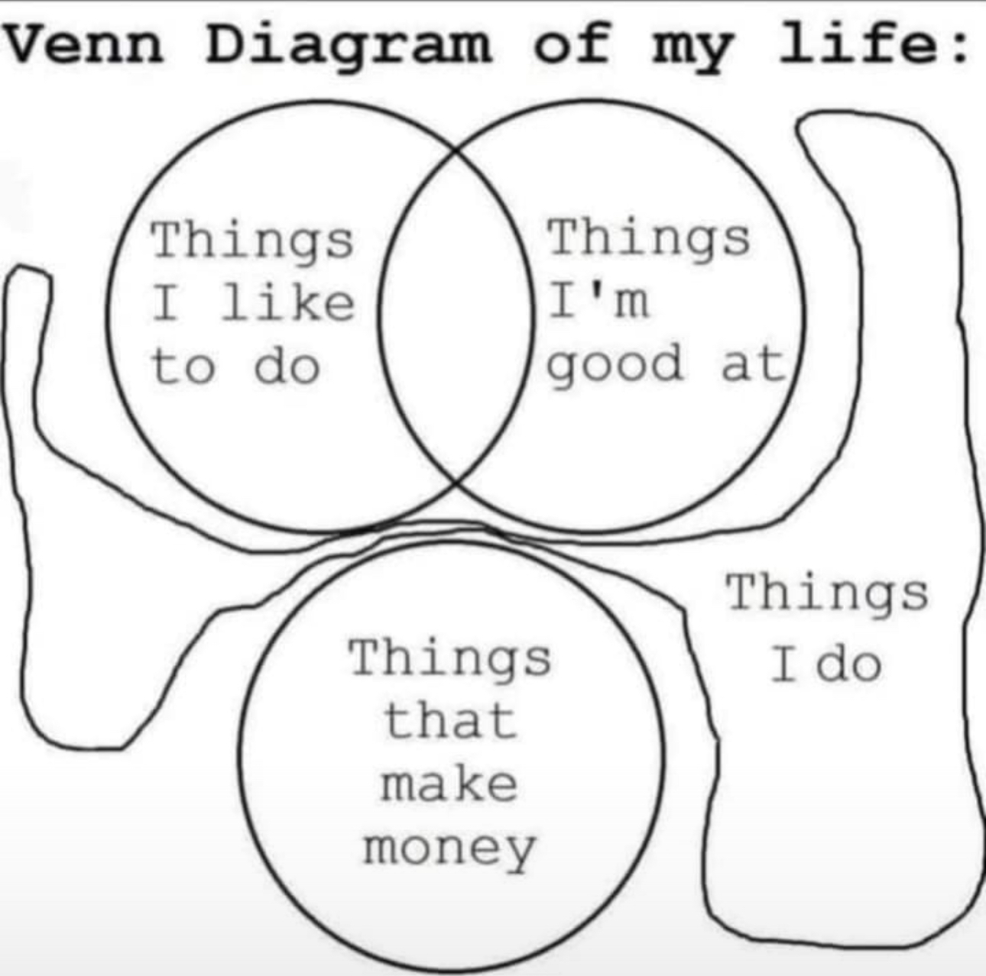
Core Problem

Slide 5
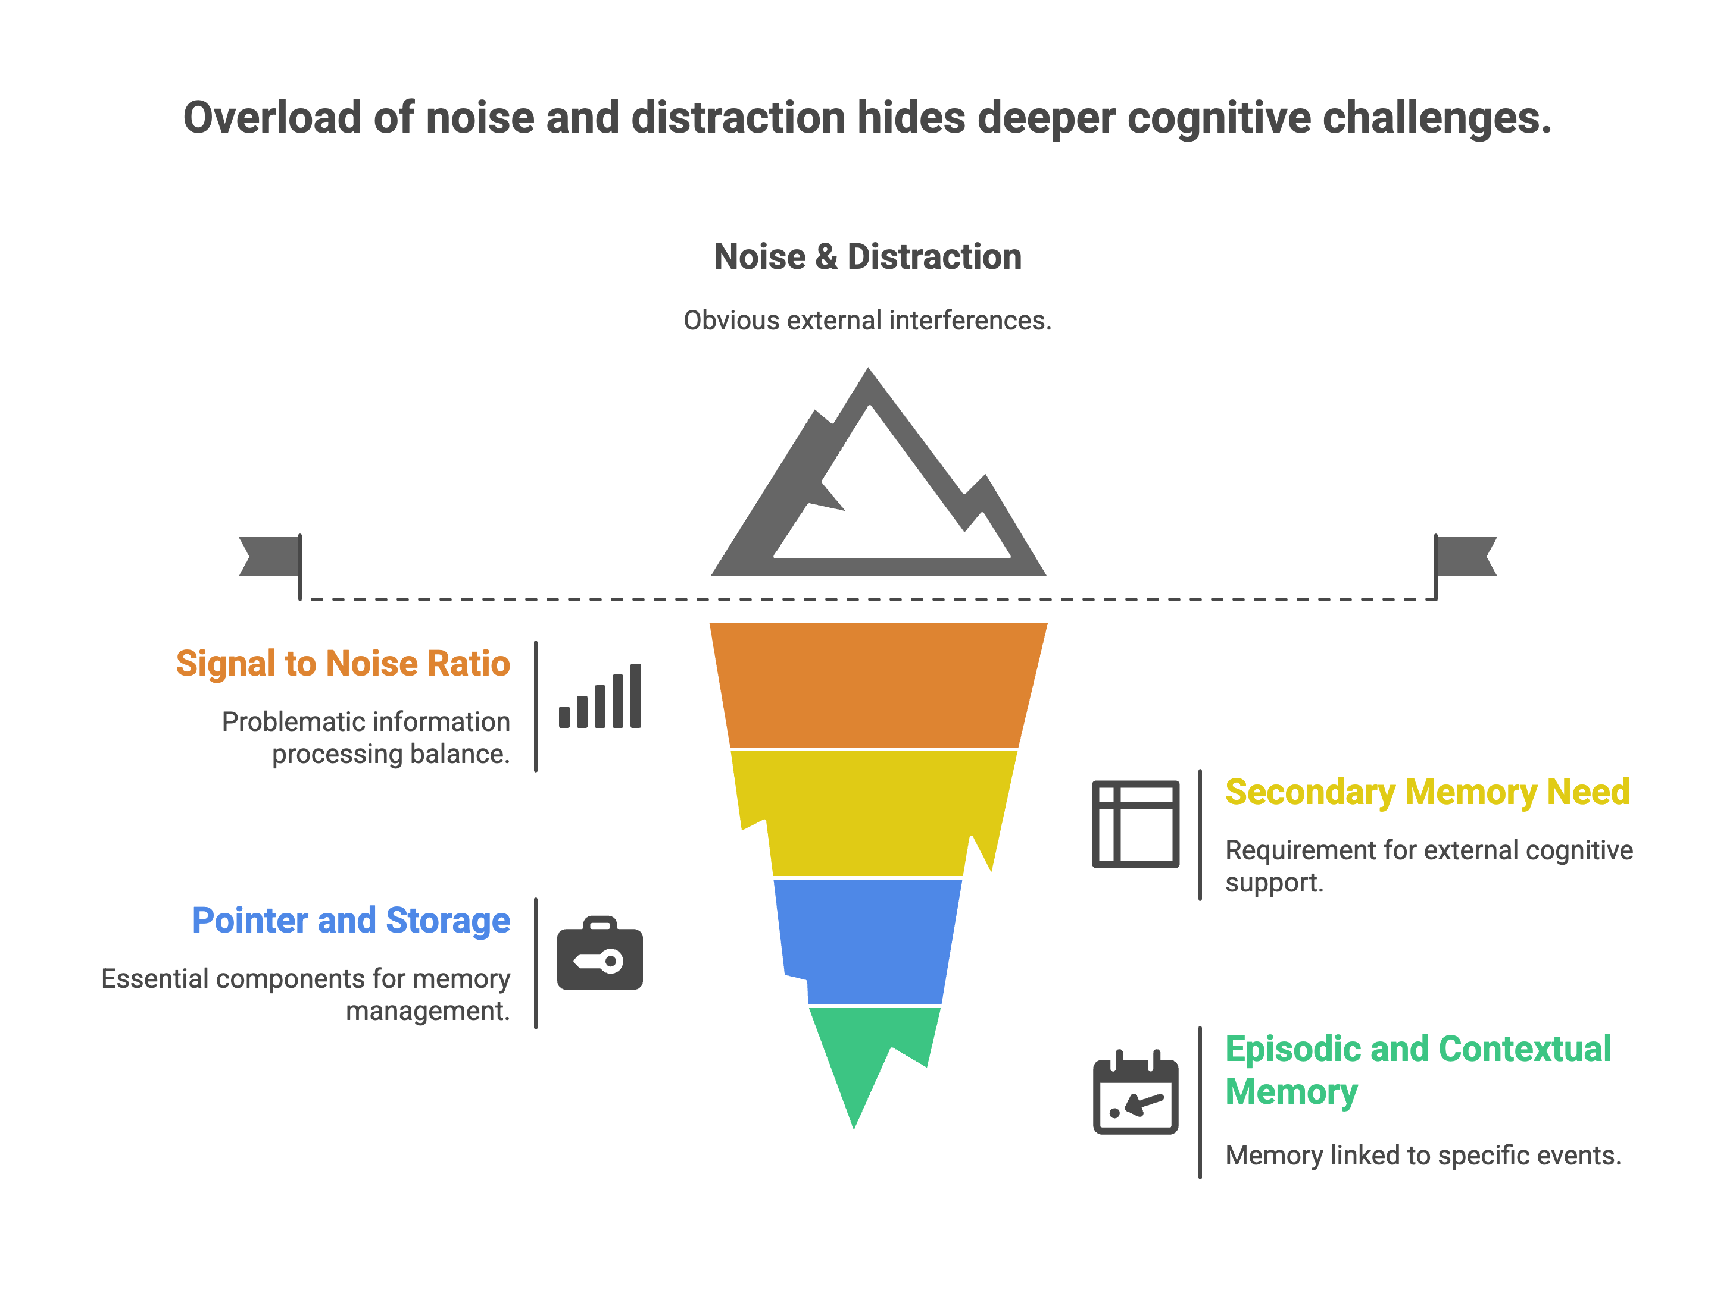

Slide 6
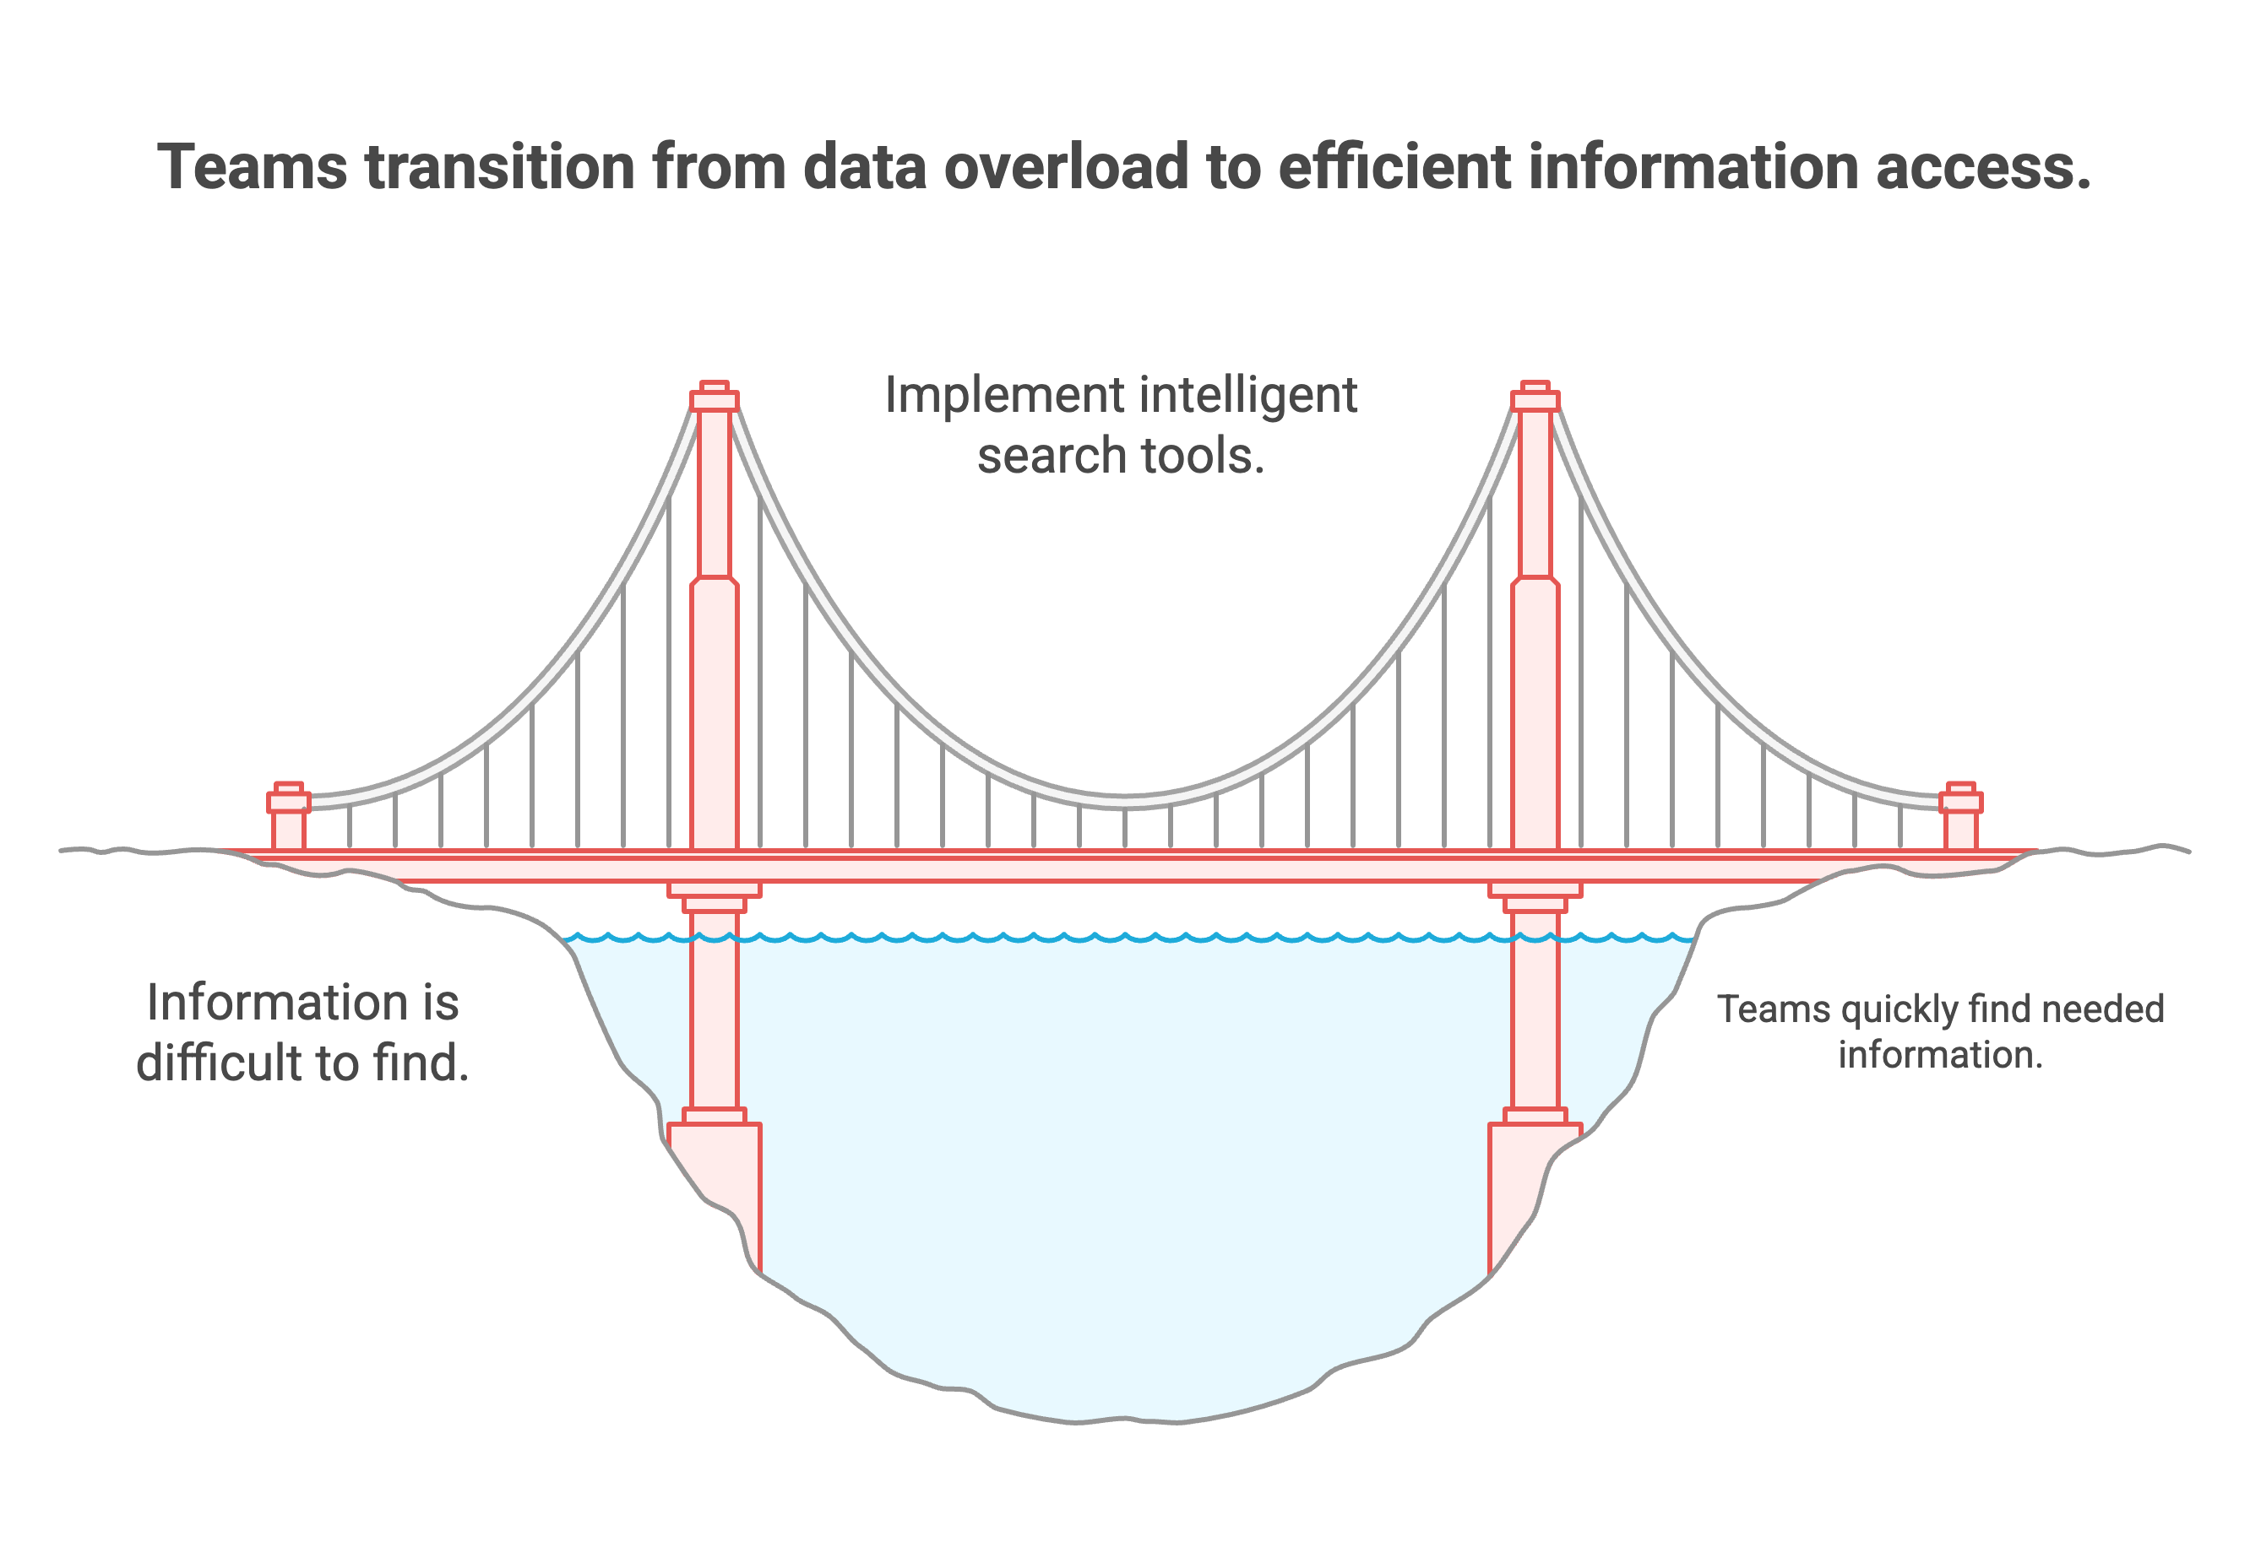

Slide 7
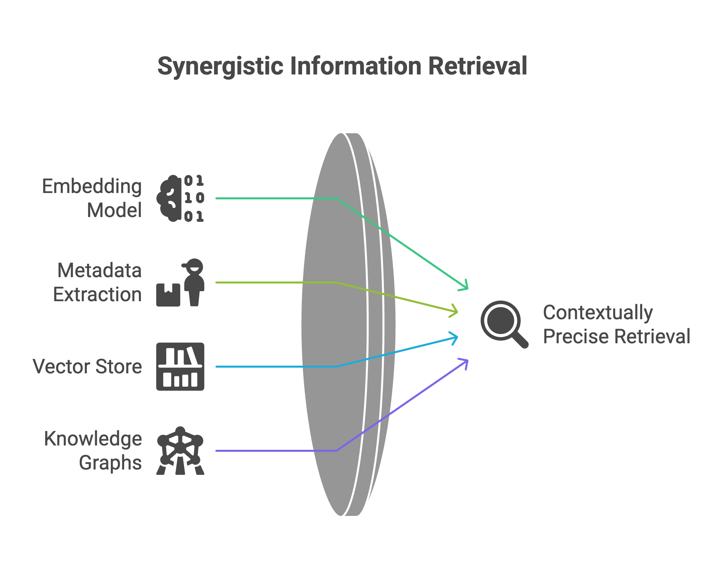

Slide 8
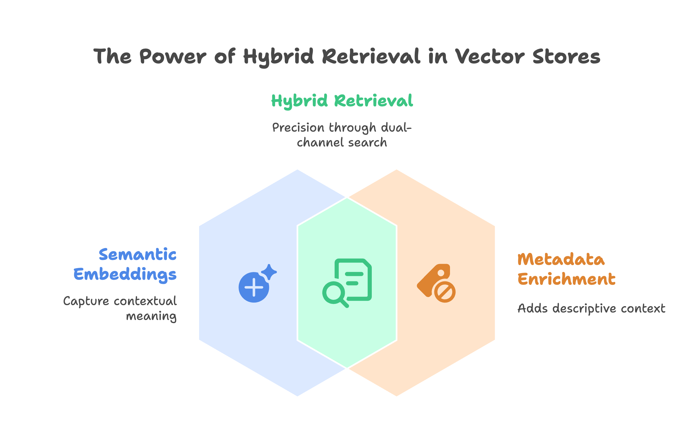

Slide 9
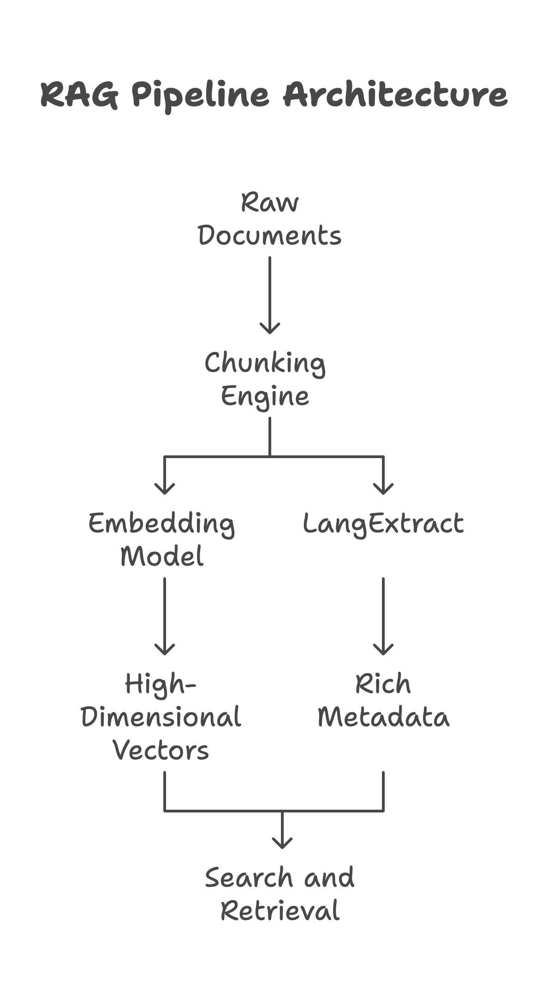

Slide 10
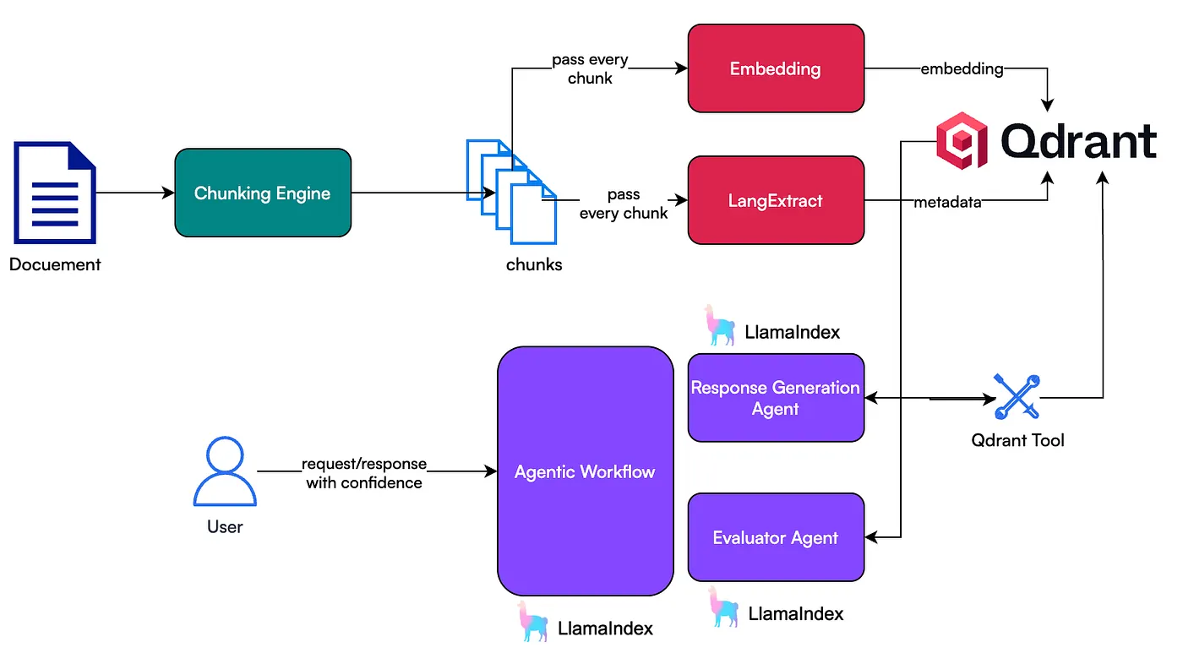

Slide 11
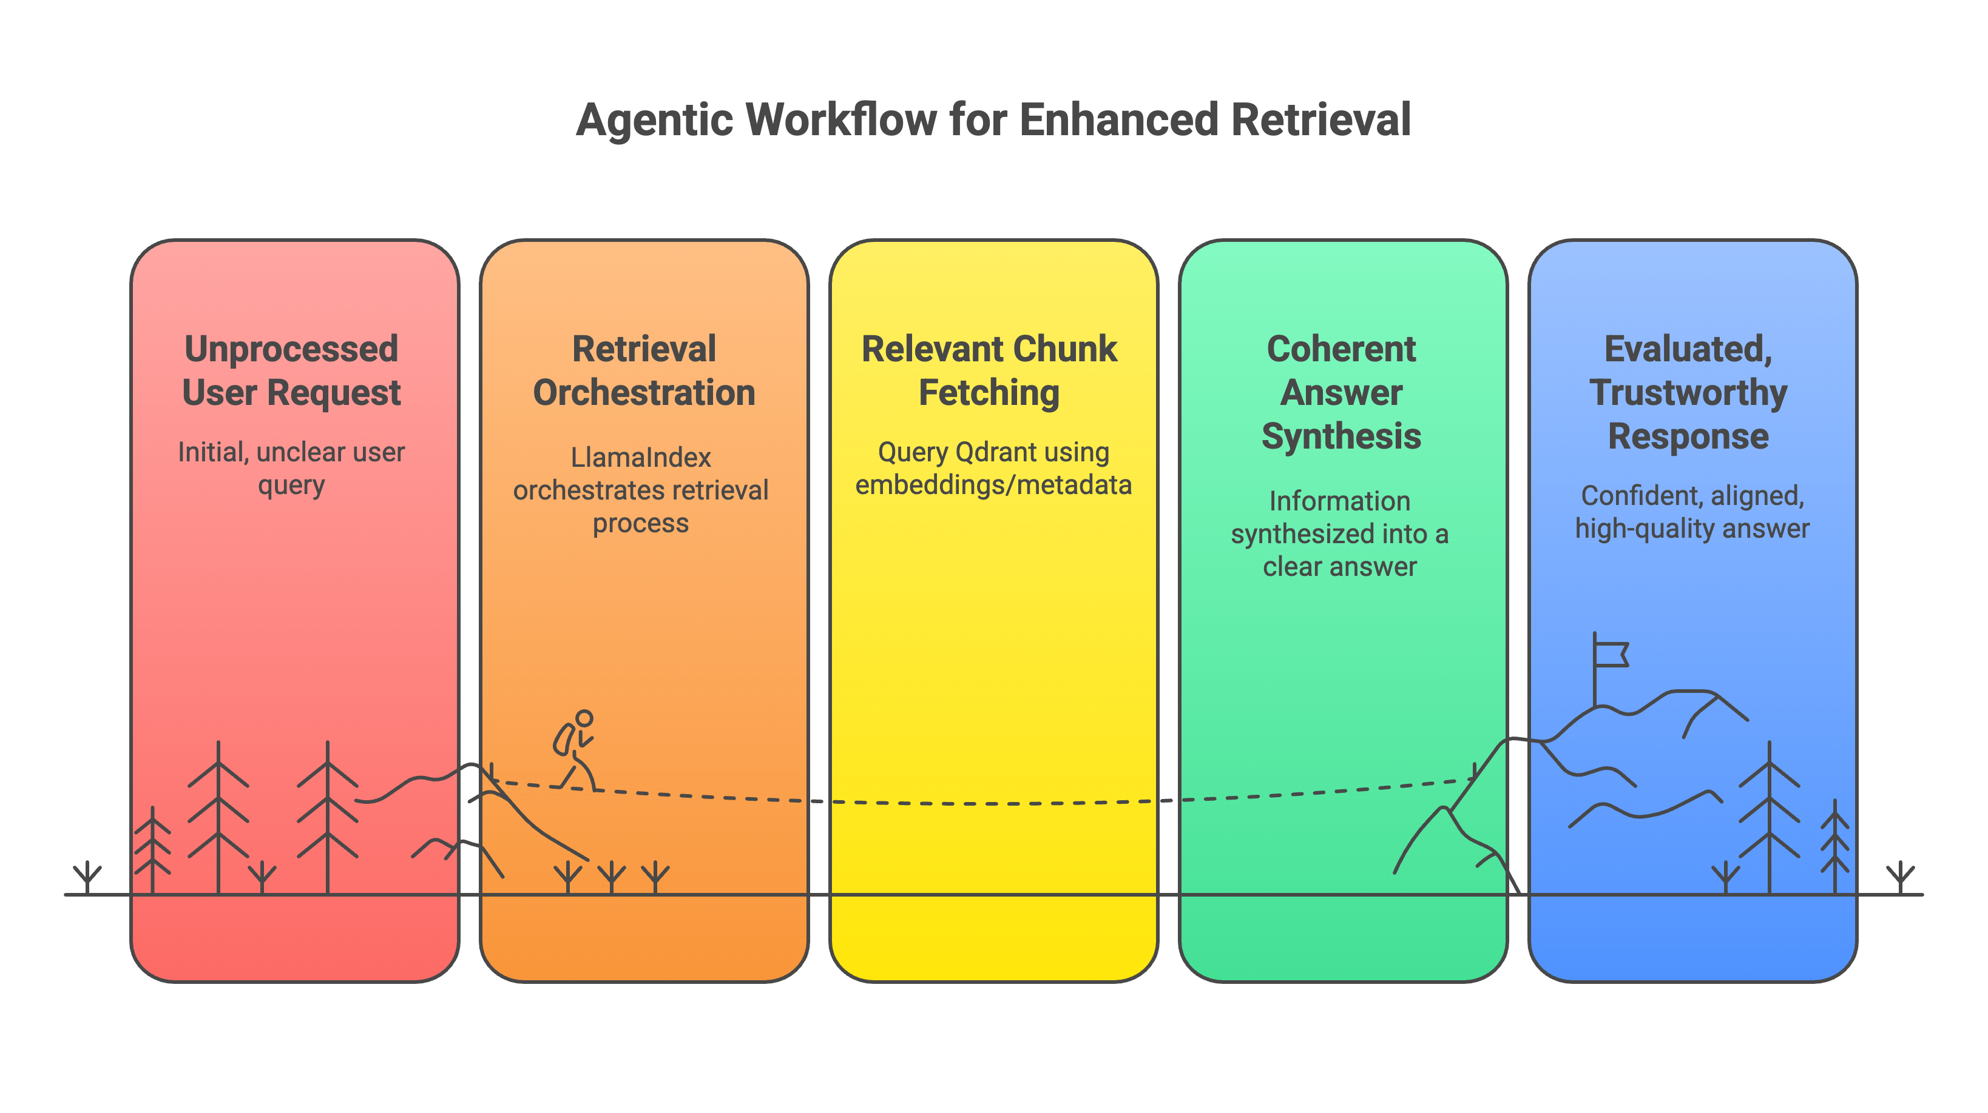

Slide 12
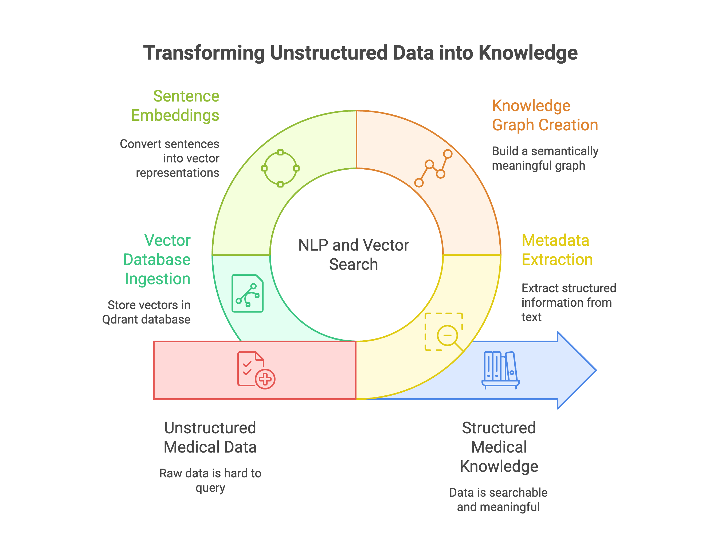

Slide 13
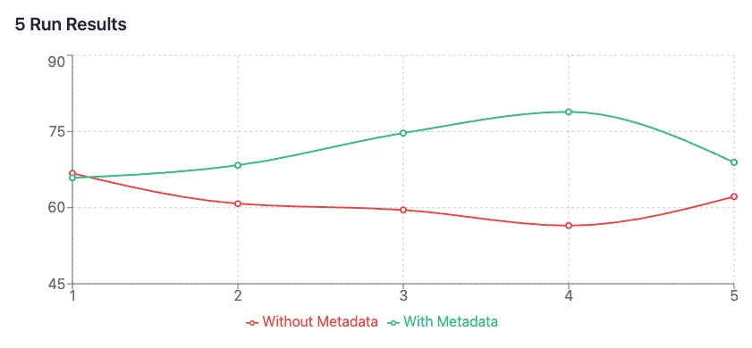
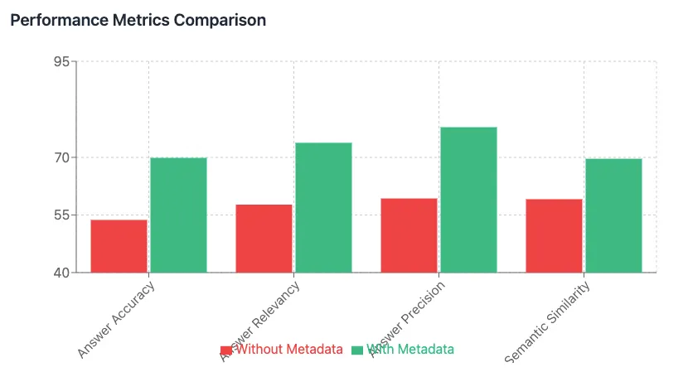
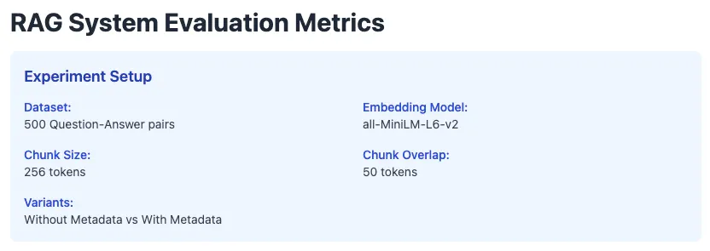

Slide 14
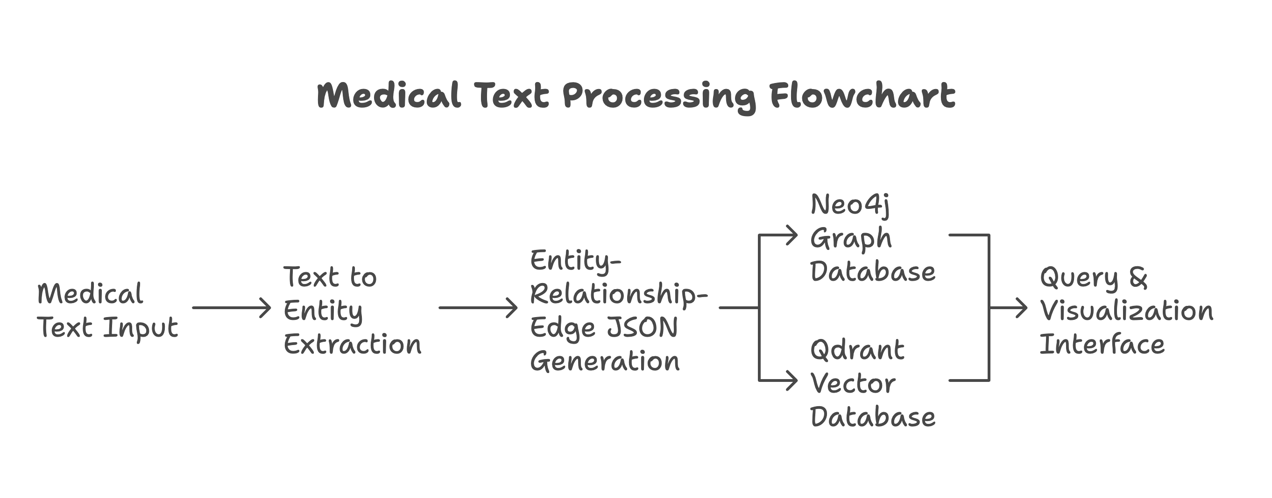

Slide 15


Live Demo
Medical Data extraction & Management

Slide 16
Where are can we use it

Slide 17
Empowering Clinicians at the Point of Care.
The Scenario: A doctor enters a patient's symptoms. The system queries the KG in real-time to suggest diagnoses, flag potential drug interactions, and recommend evidence-based treatment pathways.
The Value Proposition: We reduce the clinician's cognitive load, improve diagnostic accuracy, and enhance patient safety—a direct demonstration of mission-critical reliability.

Slide 18
Finding the Needle in the Haystack, Faster.
The Scenario: Researchers ask, "Which existing drugs target proteins in the same biological pathway as Gene X, recently implicated in Alzheimer's?"
The Value Proposition: This massively accelerates hypothesis generation and drug repurposing, de-risking the R&D pipeline and potentially saving millions of dollars and years of work.

Slide 19
From One-Size-Fits-All to N-of-1 Medicine.
The Scenario: The KG integrates a patient's unique genomic data, EHR history, and lifestyle factors to identify the optimal, personalized treatment plan.
The Value Proposition: This moves healthcare from reactive to predictive, improving treatment efficacy and delivering on the true potential of modern medicine.

Slide 20
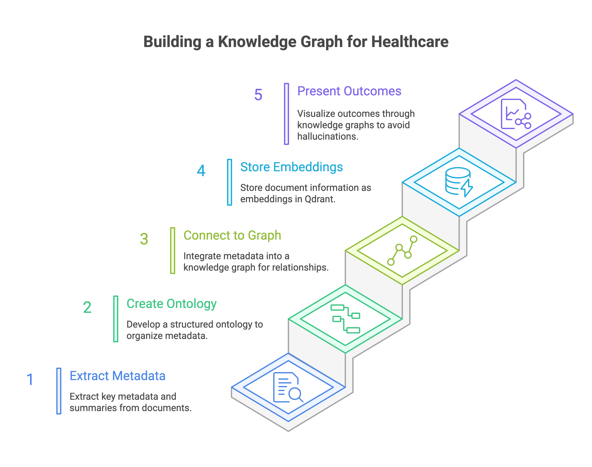
Enterprise Document Intelligence

Slide 21
Live Demo
Knowledge Graphs + Vector DBs

Slide 22
Thank you
Collective intelligence of agents

